Slide 1

Safer Technologies 4 Schools
NZ Market Briefing
October 2022
Notes:
I wish to acknowledge the Wurundjeri people of the East Kulin Nation, Traditional Custodians of the land on which ESA’s offices are located and pay my respects to Elders past, present and emerging.
I also acknowledge and pay my respects to the past, present and future Traditional Custodians and Elders of this nation and to the continuation of cultural, spiritual and educational practices of Aboriginal and Torres Strait Islander peoples.

Slide 2
What is ST4S?
An assessment framework for digital products and services used in the Australian & New Zealand Education Sector against agreed criteria for:
Security
Privacy
Functionality / Online Safety
Interoperability
Administered by Education Services Australia
Notes:
.

Slide 3
Who is ESA?
Education Services Australia is a national not-for-profit company owned by the state, territory and Australian Government education ministers
ESA was established by education ministers in 2010 to advance key nationally agreed education initiatives, programs and projects
National Schools Interoperability Program (NSIP) established in 2010 targeting standards in digital learning infrastructure and interoperability
NSIP are now a business unit of ESA
The ESA NSIP program is operationally informed by the NSIP Steering Group made up of:
  CIOs from each Government State & Territory
  Catholic & Independent sector representation
  DESE, ACARA & ESA
NSIP manage the SIF-AU data model, NAPLAN Online data specifications, HITS other data tools and services and ST4S.
Notes:
.

Slide 4
Why ST4S?
School systems made up of increasing number of solutions:
Student administration, Finance, HR
Learning management, online tools, games
All systems and data:
Subject to malicious attack
Can suffer accidental or deliberate misuse
Confidence needed in entire education ecosystem to:
Support daily school operations
Prevent harm
Notes:
.

Slide 5
Objectives of ST4S
  Common message to EdTech market: Security, privacy, online safety and interoperability are important for the Education Sector
  Reduce administrative burden for Education Sector and for Vendors
  Gaps are identified and addressed
  Engagement - All education authorities and vendors are active participants in the process
Notes:
.

Slide 6
ST4S Assessment Framework
  Set of control questions and possible answers
  Geared to online products / services
  Links back to Australian ISM, New Zealand ISM, Privacy Laws, Other standards (OWASP etc)
  Assessments occur against a particular version of the assessment framework
  Framework updated every 6-12 months
  Security and privacy are constantly evolving
Notes:
.

Slide 7
Assessment Tiers
  Not all products/services are the same
  Payment processing
  Mental health and wellbeing
  ABC website
  ST4S considers:
  Data processed/stored
    No personal information > Tier 3
    Personal information > Tier 2
    Sensitive information > Tier 1
  Functionality
    Communications – Video/Chat
    Riskier functionality – Tier 1
Notes:
.

Slide 8
Assessment process
1. Supplier completes Readiness Check
2. Supplier prioritised
3. Supplier completes full assessment
Open to all suppliers 24/7
Working group meet monthly
Collaborative assessment
Evidence documents
Technical checks
Coherence

Slide 9
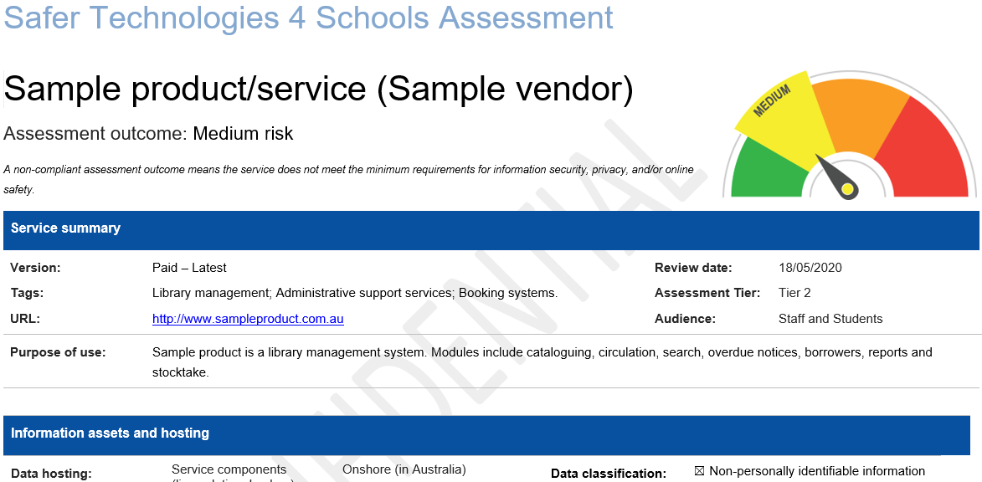
End result

Slide 10
End result

Slide 11
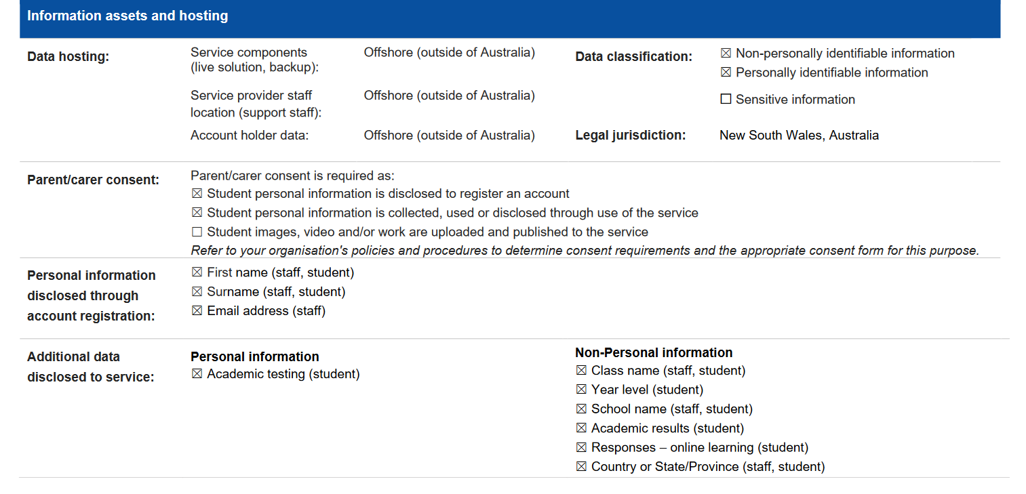

Slide 12
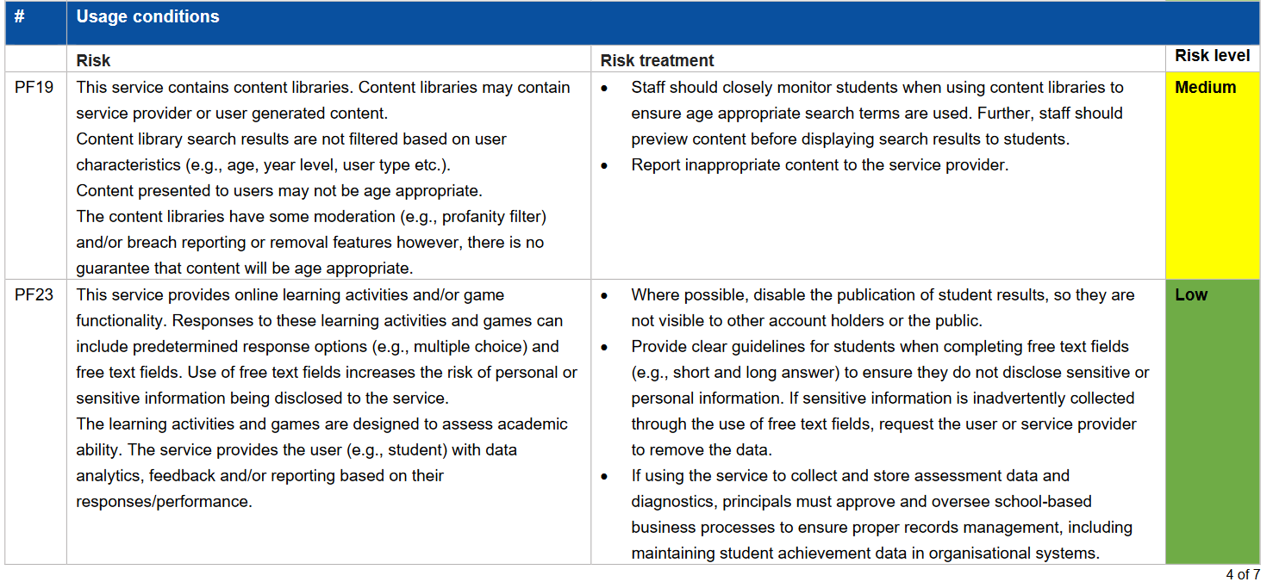
Actionable Risks & Treatments

Slide 13
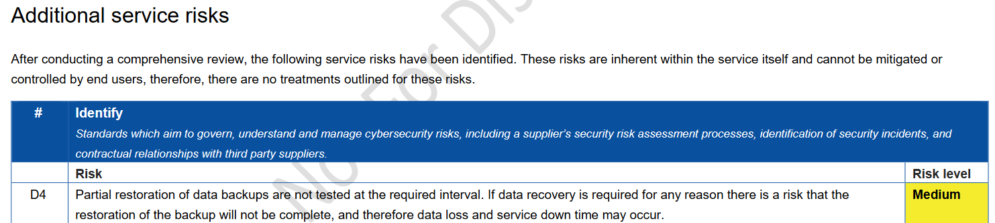
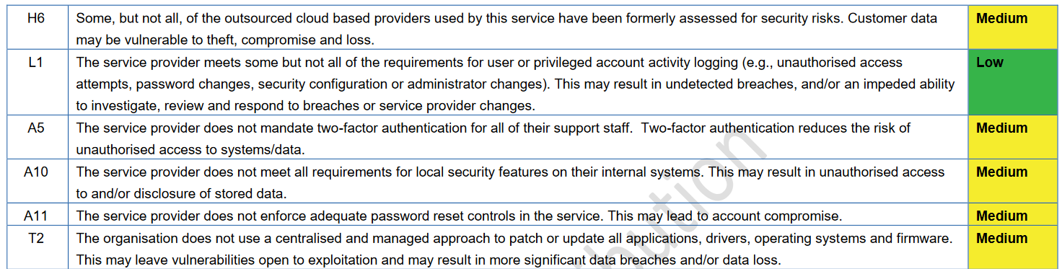

Slide 14
Progress to date
Over 200 products/services assessed
5+ revisions to the ST4S Assessment Framework, 2022.1 framework covers AU and NZ controls
30+% of vendors make changes to improve their offerings
Commitment to complete an additional 80 assessments this financial year
Notes:
.

Slide 15
Important
Assessments are NOT a guarantee that the product/service is safe
They are an assessment of a vendor’s responses to the ST4S assessment framework
Cannot take into account local context, local controls, staff training etc
Procurement decisions are the school’s / Department’s/ Sector’s
Notes:
.

Slide 16
Get involved
ST4S Readiness Check
Available to all suppliers – no invitation required
Highlights critical gaps
First step st4s.edu.au/readiness-check
ST4S Supplier Reference Group
New group to be established
Feedback on ST4S Assessment Framework and initiative
Notes:
.

Slide 17


ST4S Badging
Products visibly distinguishable
Public page where participating products listed
Rules
  Participated fully
  Completed assessment post-pilot (2020+)
  Low or Medium outcome
  Commit to annual readiness check
  Agreement
Notes:
.

Slide 18
Thank-you
Notes:
.

